Slide 1


Slide 2


Slide 3
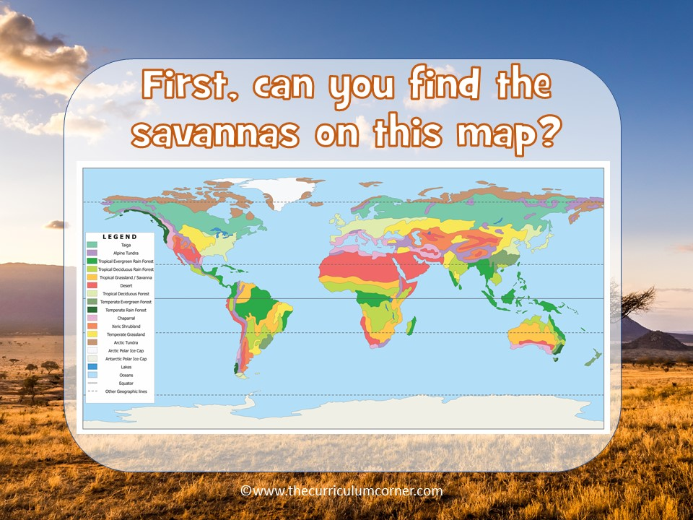

Slide 4
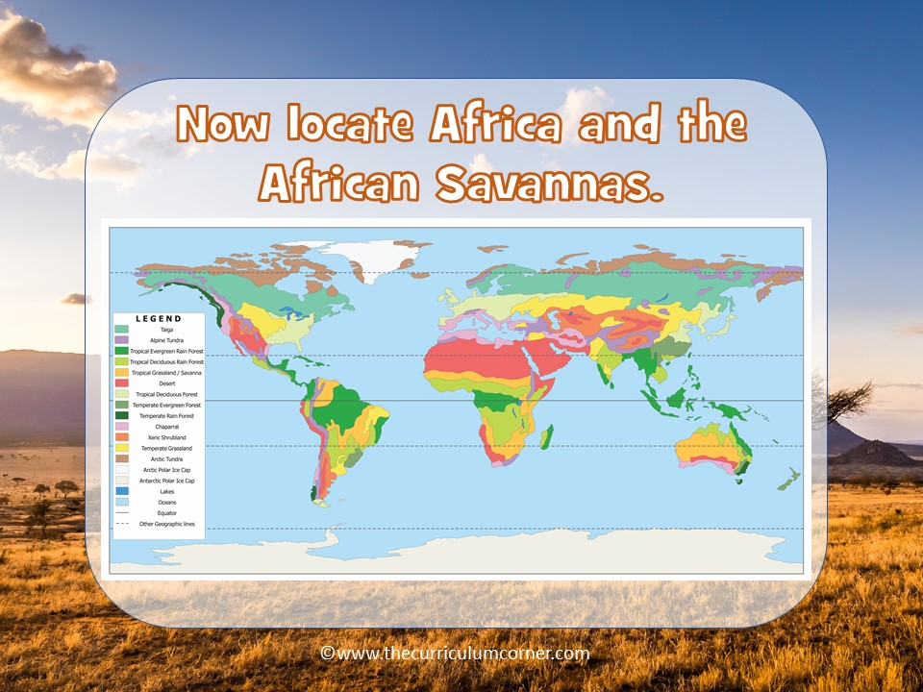

Slide 5
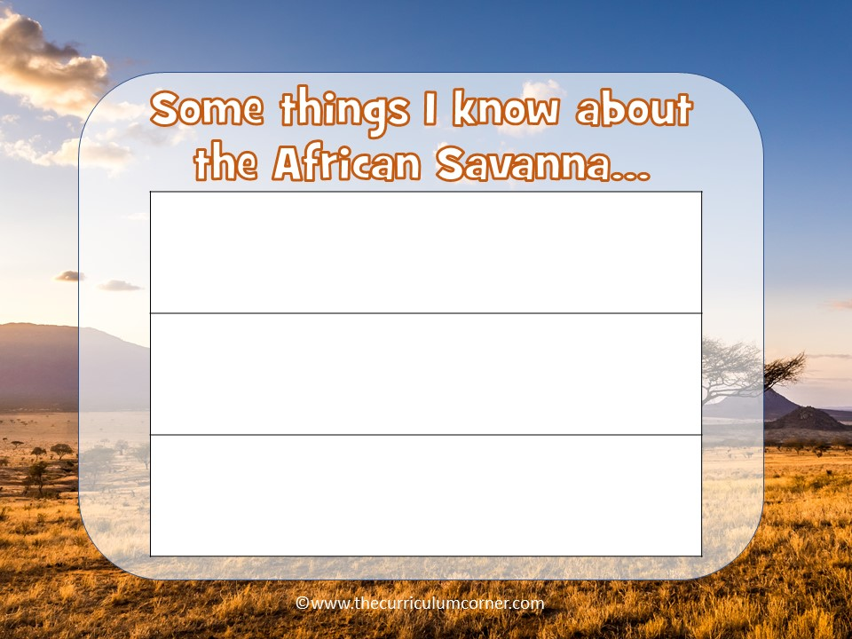
answer here
answer here
answer here

Slide 6
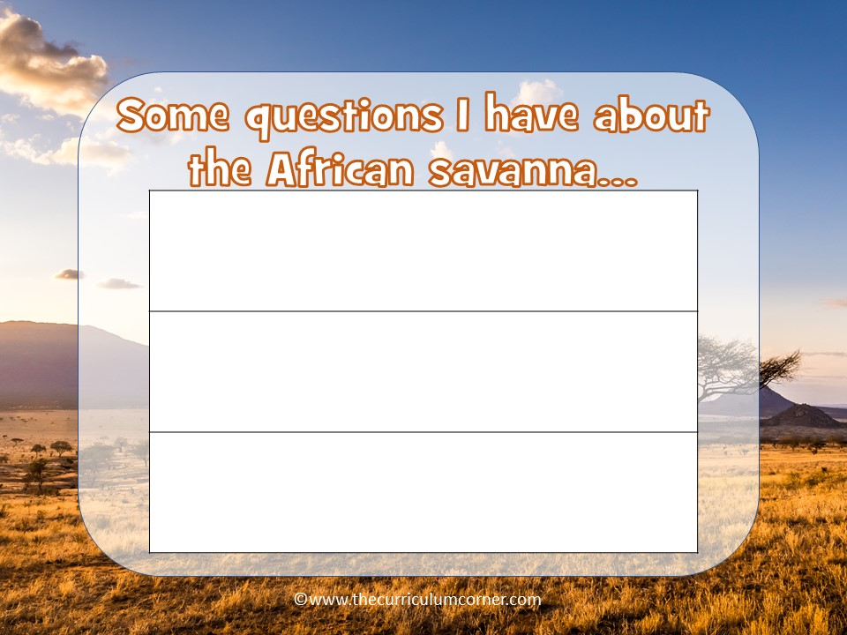
answer here
answer here
answer here

